Slide 1

2023 3rd International Conference on Smart Generation Computing, Communication and Networking (SMARTGEN) (SMARTGENCON 2023)
CureNet: Improving Explainability of AI Diagnosis Using Custom Large Language Models
Paper ID: 361
PRESENTER NAME
AMRITA CENTER FOR WIRELESS NETWORKS AND APPLICATIONS

Slide 2

Contents

Slide 3

PROBLEM STATEMENT
The lack of interpretability in current Deep Learning models for cardiac diagnostics presents a critical obstacle to making precise decisions. This research aims to address this challenge by proposing a clinician-in-the-loop, prompt-based Explainable AI tool, enhancing transparency and accuracy in Deep Learning-based cardiac health diagnostics utilizing ECG datasets.

Slide 4
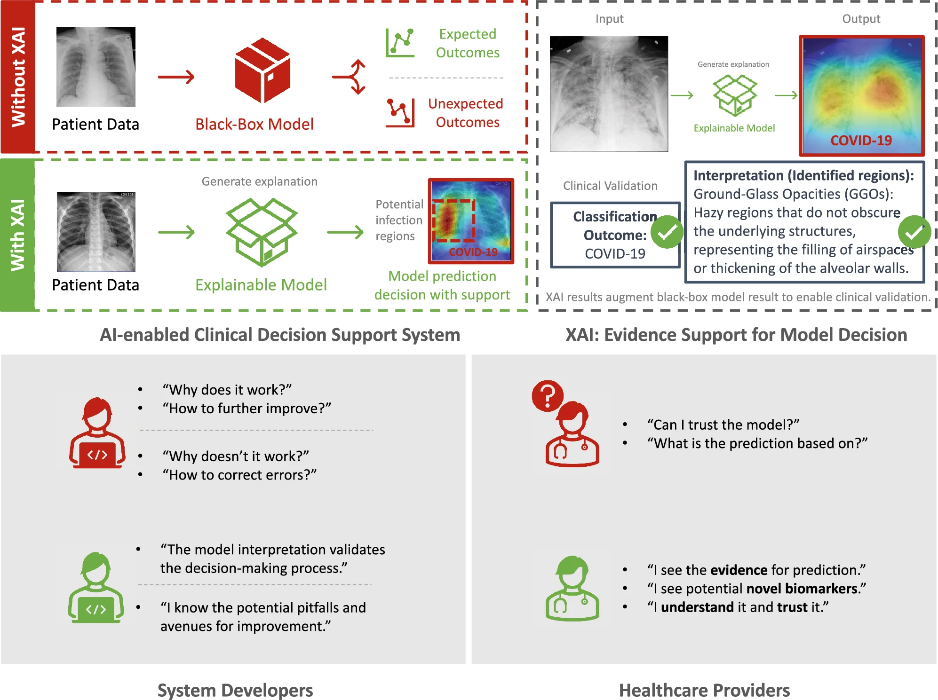
NEED FOR EXPLAINABILITY

Slide 5
Operation Cycle
Executing the Algorithm: Unveiling the Operation Cycle
Data Refinement
Model Training
Preprocessing the acquired Data
Training the model with the preprocesses data
Doctor Interaction
Data Collection
Acquiring the Data
Interface of the chatbot where Doctors can interact
Transparency Integration
Applying different
Explainable AI techniques to the trained model
Chat Bot Training
Training the chat bot with the model data and Medical Knowledge of signals

Slide 6
DATA
PHYSIONET 2020
The data for this Challenge are from multiple sources:
A0001 12 500 7500
A0001.mat 16+24 1000/mV 16 0 28 -1716 0 I
A0001.mat 16+24 1000/mV 16 0 7 2029 0 II
A0001.mat 16+24 1000/mV 16 0 -21 3745 0 III
A0001.mat 16+24 1000/mV 16 0 -17 3680 0 aVR
A0001.mat 16+24 1000/mV 16 0 24 -2664 0 aVL
A0001.mat 16+24 1000/mV 16 0 -7 -1499 0 aVF
A0001.mat 16+24 1000/mV 16 0 -290 390 0 V1
A0001.mat 16+24 1000/mV 16 0 -204 157 0 V2
A0001.mat 16+24 1000/mV 16 0 -96 -2555 0 V3
CPSC Database and CPSC-Extra Database
INCART Database
PTB and PTB-XL Database
The Georgia 12-lead ECG Challenge (G12EC) Database
Undisclosed Database
- Each ECG recording has one or more labels from different type of abnormalities in SNOMED-CT codes..
St_petersburg_incart , 74 recordings
Cpsc_2018, 6,877 recordings
Cpsc_2018_extra, 3,453 recordings
Ptb, 516 recordings
Ptb-xl, 21,837 recordings
Georgia, 10,344 recordings

Slide 7
Deep Learning Models
RESNET
CONV NET
RESIDUAL CONV NET
Relu Activation
Batch Normalization
Residual Blocks
Dropout
Global Average pooling
Softmax
ADAM
LeakyRelu Activation
Batch Normalization
Residual Blocks
Dropout
Global Average pooling
Flatten
Softmax
ADAM
Convolutional Layers
Relu Activation
Batch Normalization
Global Average pooling
Softmax
SGD

Slide 8
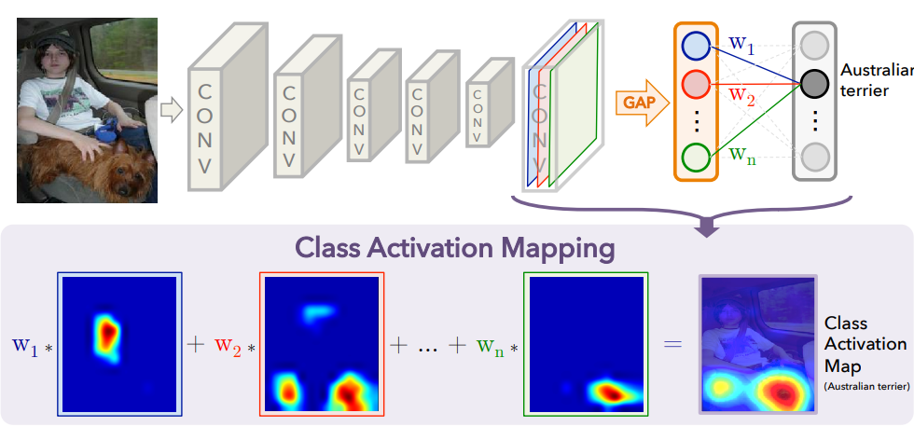
XAI

Slide 9

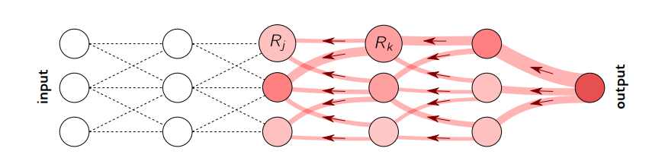
LayerWise Relevance
Principle: LRP assigns relevance to neurons by backpropagating prediction scores to inputs, revealing significant input parts for neuron activation.
Advantage: LRP is model-agnostic and provides detailed insights into the contribution of each neuron and feature. It offers a structured way to analyze the model's internal behavior.

Slide 10
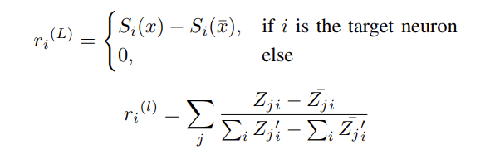
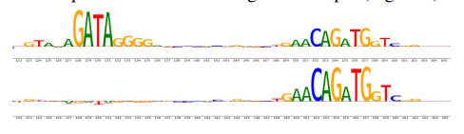
DeepLift
Principle: DeepLIFT aims to attribute the difference in output between a reference input (baseline) and an actual input to the input features. It quantifies how much each feature contributes to the change in output prediction compared to the baseline. .
Advantage: DeepLIFT is not restricted to specific classes and can be used for individual samples or groups of samples.

Slide 11
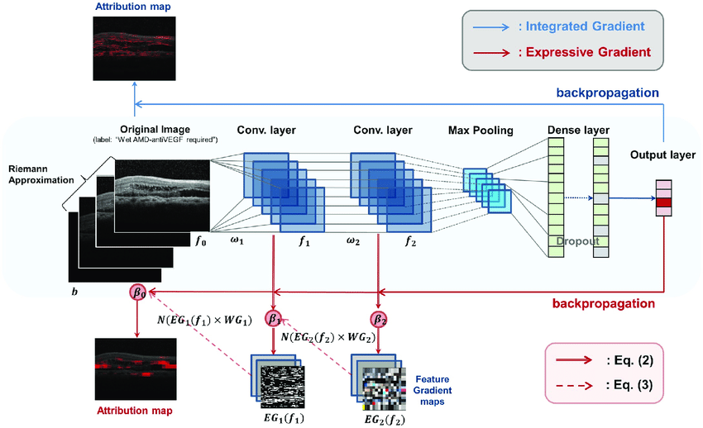

Integrated Gradients
Principle:IIntegrated Gradients quantifies feature impact on model prediction by integrating output gradients over a path from baseline to input.
Advantage: Integrated Gradients offers a holistic view of feature importance, considering the entire input space. It provides insights into how features collectively influence the model's decision.

Slide 12
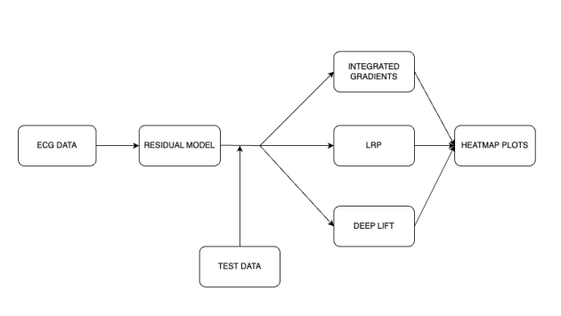
Contents

Slide 13
ChatBot
Introduction:
Developed chatbot based on Falcon 7B pre-trained language model.
Fine-Tuned on cardiac diseases, Deep Learning, and XAI.
Domain Expertise:
Engages users in informative discussions across cardiac diseases, Deep Learning models, and XAI.
Innovative Functionality:
Image retrieval feature added.
Web scraping images from trusted websites related to cardiac abnormalities.

Slide 14
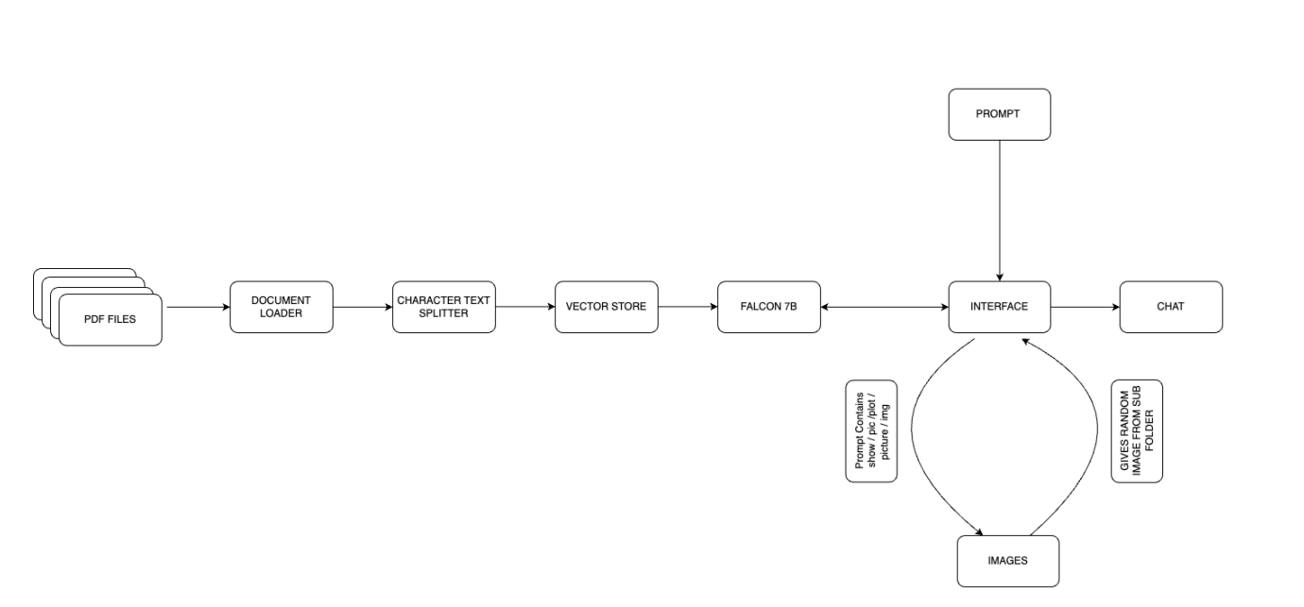

Slide 15
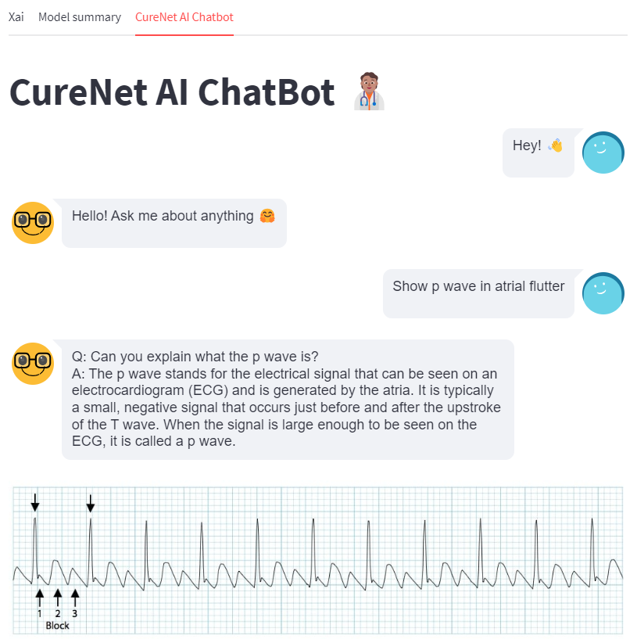
Functionality and User Interaction
Image Organization:
Systematic organization into labeled folders based on heart diseases.
Enables efficient retrieval.
On-Demand Image Display:
User requests result in relevant image display.
Retrieval from specific folders, accompanied by textual details.
Comprehensive Understanding:
Synergy of language model and image retrieval provides holistic medical topic understanding.
Explainability Enhancement:
Seamless user inquiry addressing with visual assistance.
Enhances explainability for a rich user experience.

Slide 16
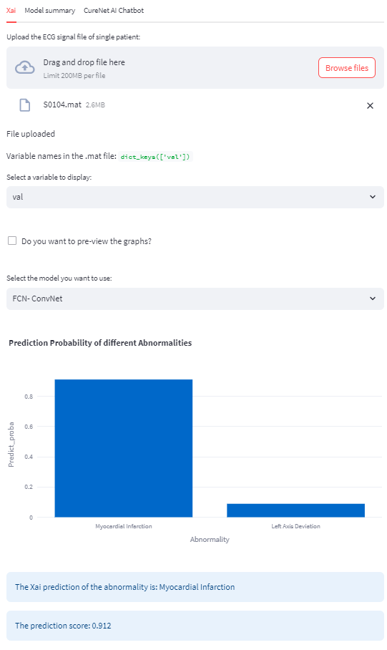
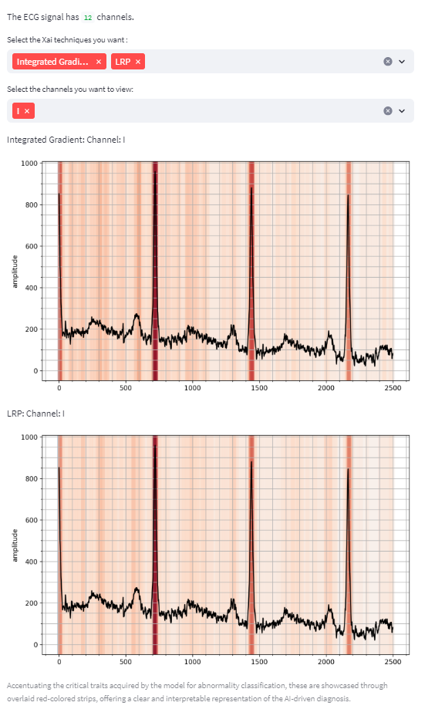
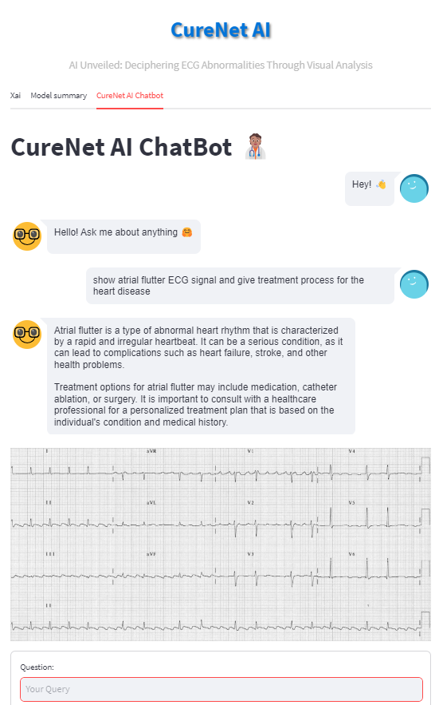
WORKING PROTOTYPE

Slide 17
Future Aspects

